Slide 1

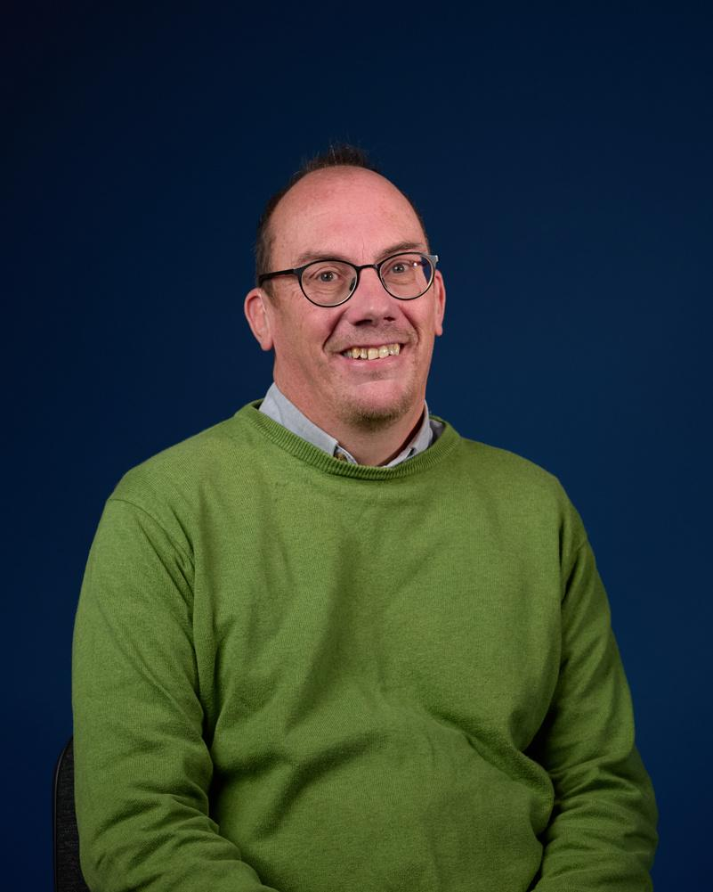

Local churches supporting global mission
PGP Partnership Day
23rd May 2024
Tim Howlett
Head of Partnerships

Slide 2
Local churches supporting global mission
Session 1 – What hasn’t changed?
Session 2 – What has changed?
Session 3 - What can be done?

Slide 3
Local churches supporting global mission
Session 1 – What hasn’t changed?
A brief bio - ‘my missionary journey’
A little bit about UFM
A short devotional
What hasn’t changed?

Slide 4
A brief bio - ‘my missionary journey’

Slide 5
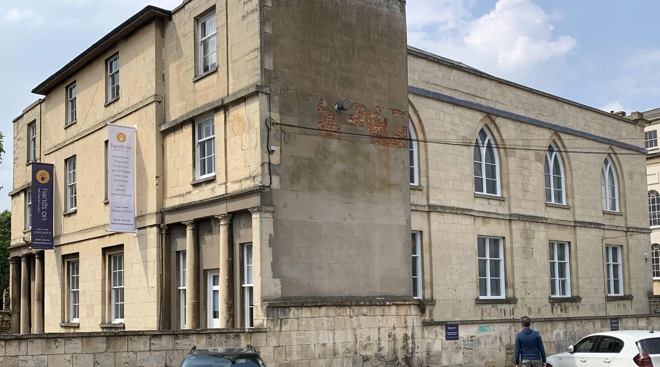

Slide 6

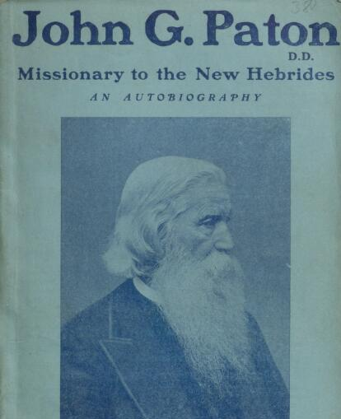

Missionary meetings
Biographies
Willingness to go!

Slide 7
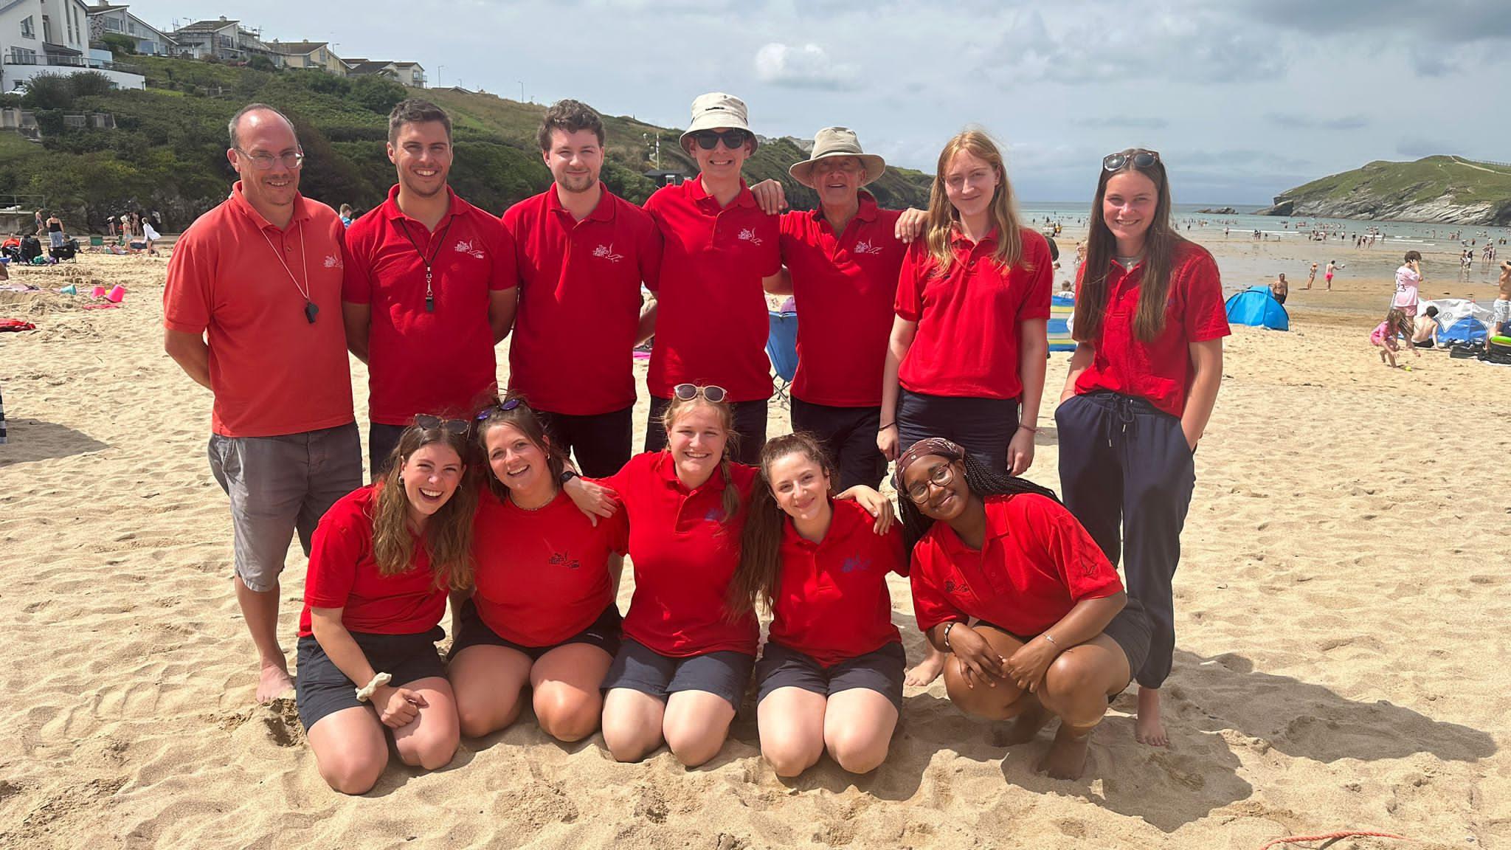

Slide 8
A little bit about UFM

Slide 9
Supporting churches in making disciples of all nations
Notes:
This is our tagline
Local churches and local church leaders are best placed to identify, train, send and support workers for cross cultural mission service - both long-term and short-term.
UFM is here is support churches and mission partners in these things.

Slide 10


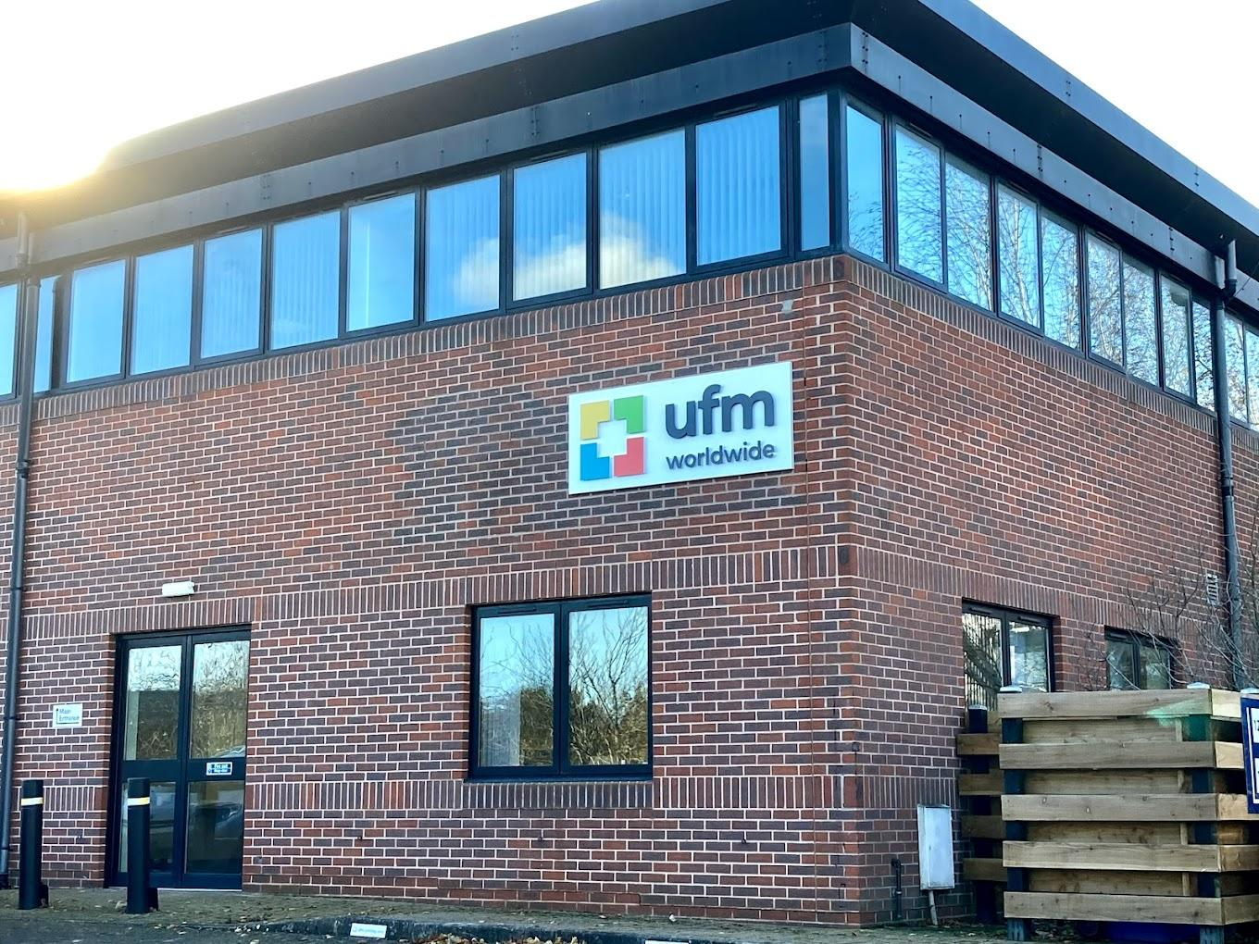
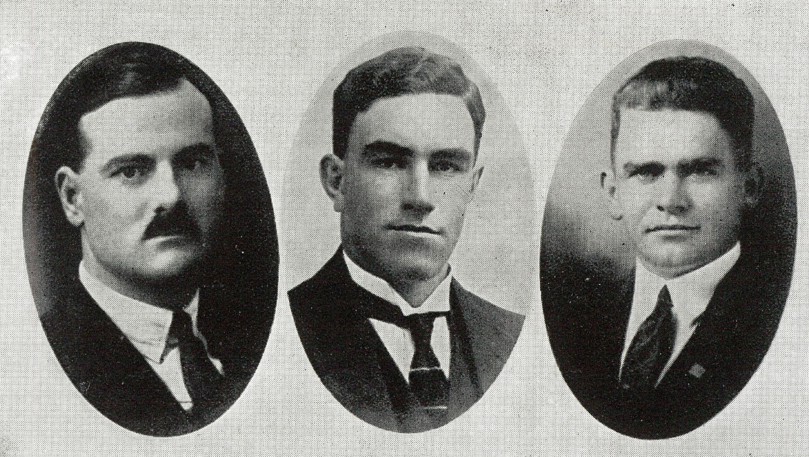
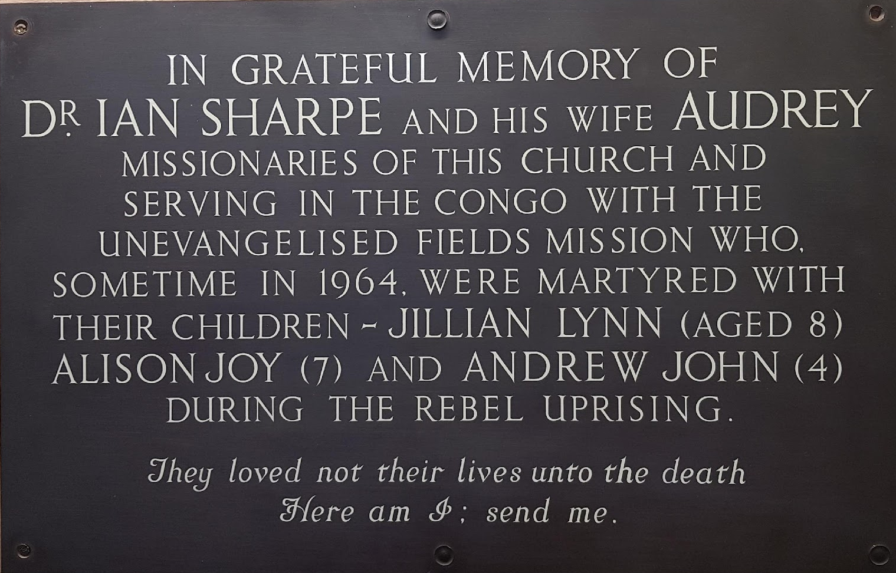
UFM’s History
1931
The Start
1935
The 3 Freds
1964
Simba Rebellion
Today
Growing!
Founded as Unevangelised Fields Mission.
Fred Wright, Fred Dawson, Fred Roberts martyred in Brazil.
13 UFM missionaries and 6 children killed in Congo. 1 UFM missionary survived.
250%+ growth in long- term and short-term mission partners since 2008/9.

Slide 11
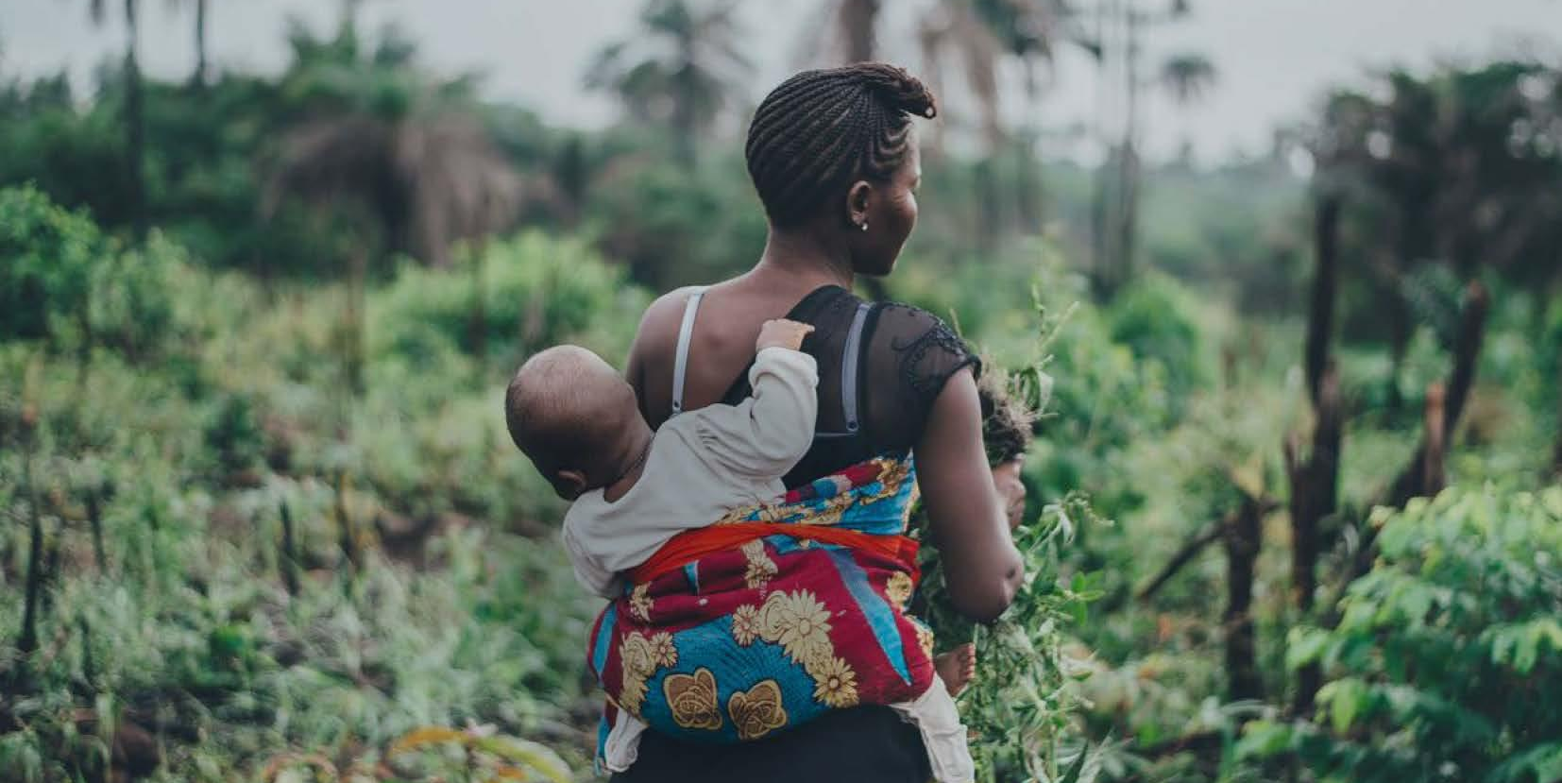
  293
  currently
  (as at 31/05/24)
  mission partners
  206 long term
  48 short term
  39 on summer teams
  (+ another 31 100Fold volunteers)
  from
  35
  nationalities
  sent by
  157
  gospel-hearted churches
  working in
  52
  countries
  (+ UK/USA based visit other countries)
Notes:
These figures are always changing – but these are correct as at May 2024.
the long term are the current number at May 2024
the short term is the total number that have done/are doing short term mission in this financial year (some are current, some have now finished in this year)
About half are in Europe.

Slide 12
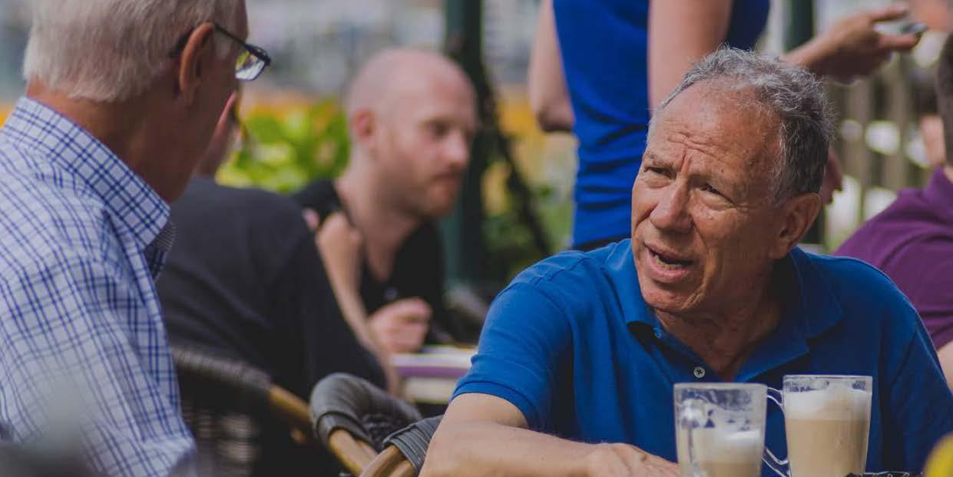
  Fellowships
  (the local church is the sender)
  Focus
  (disciple-making)
  Flexibility
  (anywhere in the world!)
  Family
  (pastoral care and support)
Notes:
This info appears in the ”We are UFM” brochure. It is TJH’s alliterated version (need to run by Michael). TJH can’t think of a better word for churches beginning with F!!
However TJH has split “committed to the Gospel” into Focus and Flexibility.
It highlights 4 distinctives
the local church is central. They have the responsibility to identify, train, send and support workers for cross-cultural mission. UFM helps churches in that task. UFM helps develop a global vision. UFM partners with churches.
Obviously we are all about proclaiming Biblical truth. Our focus is on the great commission and so our ministries are directly linked to making disciples of all nations by taking the gospel to the least reached and to serve churches that are less resourced.
- We want to enable mission partners to go anywhere.
UFM is a family. Pastoral support (in liaison with sending and receiving churches) is top priority. Flexibility is key too.
THe other distinctive mentioned in the “we are UFM” leaflet is “committed to the Lord.” Hopefully that is a given!!

Slide 13
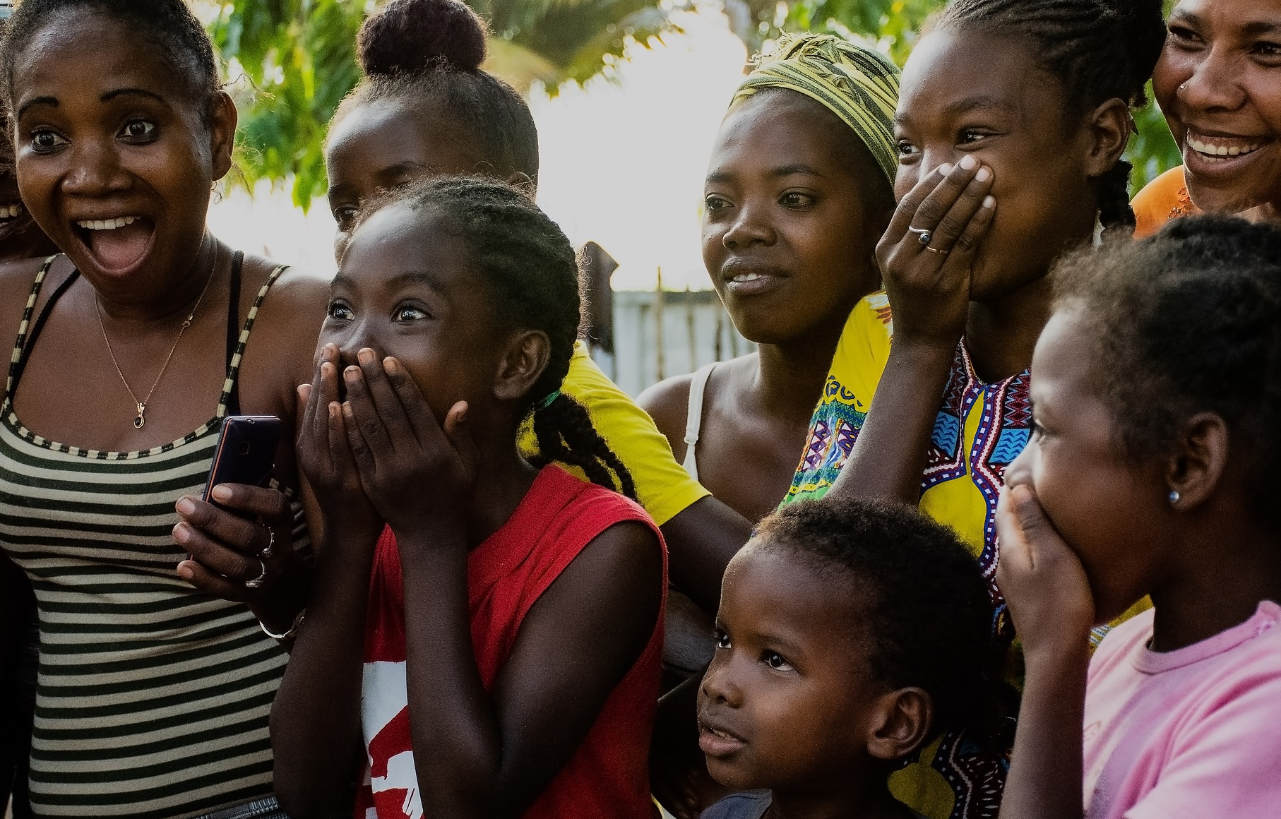
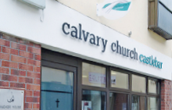
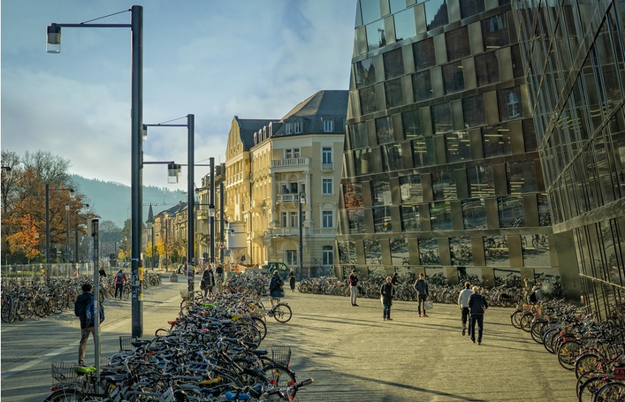
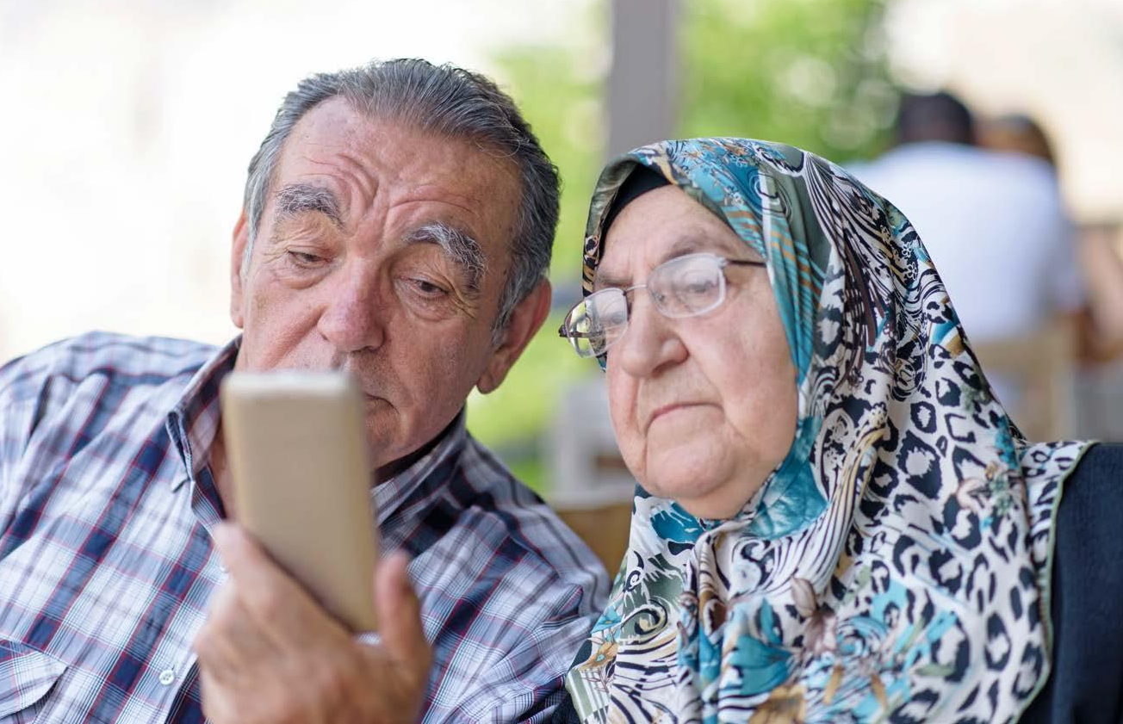
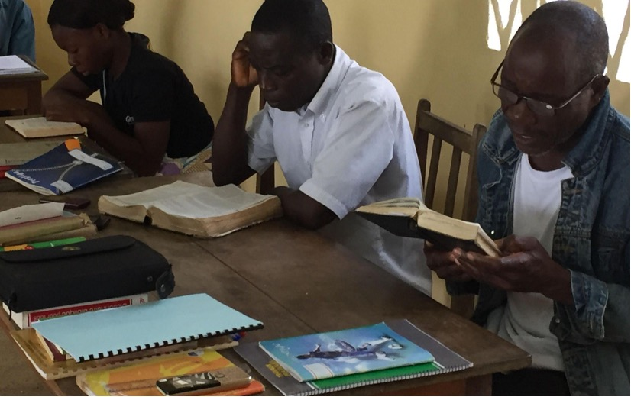
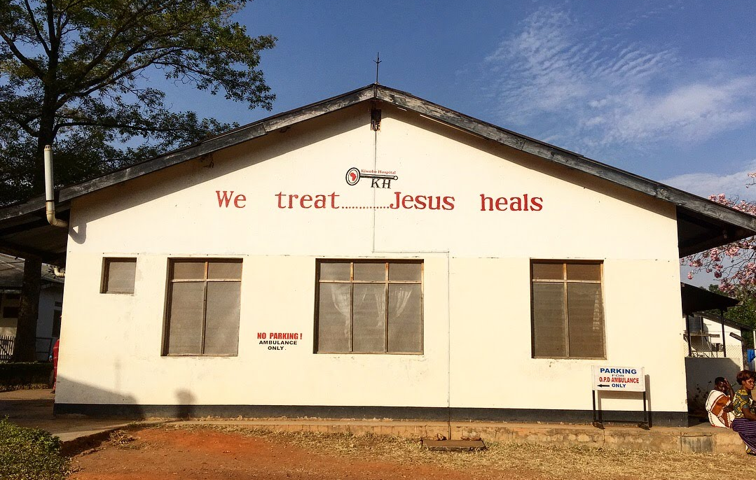
Some of the ‘vehicles’ for making disciples
  evangelism / church planting
  church leadership / discipleship
  students
  digital
  training / theological education
  medical
Notes:
This is on pages 6 and 7 of “we are UFM”
Other areas are listed such as i) supporting emerging mission movements ii) urban poor ministry iii) work among those with disabilities

Slide 14
A short devotional

Slide 15

What 3 things does global mission need?
1) New helpers (15v40, 16v1, 16v10)
Paul – a fervent man
Silas – a faithful man
Timothy – a fearful man
Luke – a forgotten man
“commended by the brothers
to the grace of the Lord.”

Slide 16
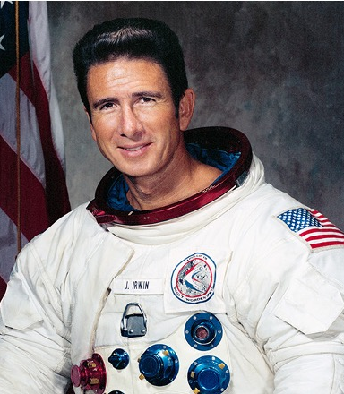
What 3 things does global mission need?
1) New helpers (15v40, 16v1, 16v10)
Paul – a fervent man
Silas – a faithful man
Timothy – a fearful man
Luke – a forgotten man
2) New horizons (16vv6-9)

Slide 17
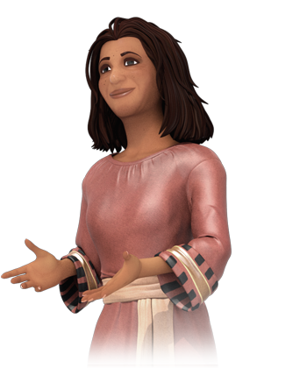
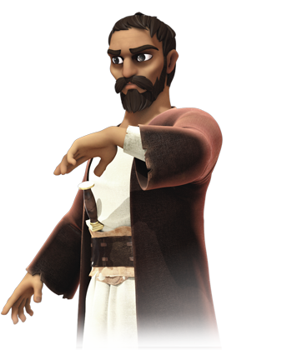
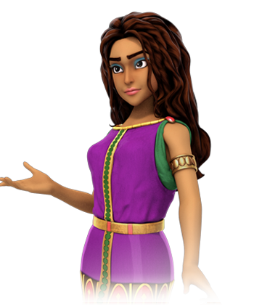
What 3 things does global mission need?
1) New helpers (15v40, 16v1, 16v10)
Paul – a fervent man
Silas – a faithful man
Timothy – a fearful man
Luke – a forgotten man
2) New horizons (16vv6-9)
3) New hearts (16v14)

Slide 18
What hasn’t changed?

Slide 19

What hasn’t changed?
1) God’s heart for mission
The start (Genesis) and end of the story (Revelation) both show God’s heart for all nations.
Notes:
Lots of good books on this

Slide 20

What hasn’t changed?
2) The need
81.7% of non-Christians on the earth do not know a Christian.
Image by Freepik - 23179501
Notes:
Source is https://www.gordonconwell.edu/wp-content/uploads/sites/13/2023/01/Status-of-Global-Christianity-2023.pdf
Other stats can be gleaned from here too.

Slide 21

What hasn’t changed?
2) The need
Of the 8,000 comuni (city, town or village) in Italy, nearly 7,000 have no evangelical church.
Photo by Arthur Yeti on Unsplash
Notes:
See https://www.impattoitalia.org/about-impatto

Slide 22
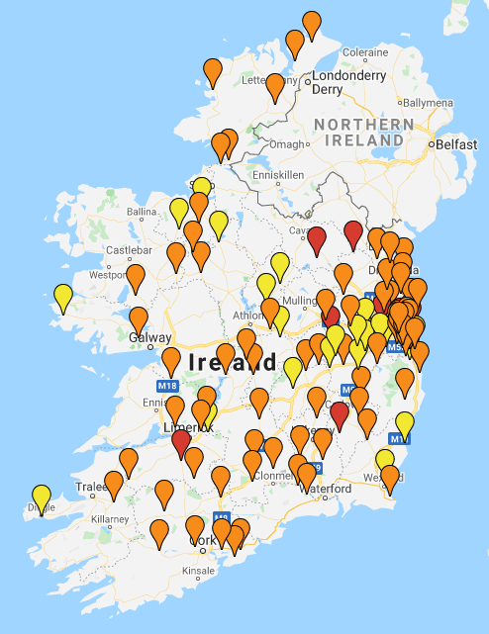
What hasn’t changed?
2) The need
There are 120 communities in Ireland of 5,000 people or more with no evangelical witness.
Yellow = 5,000-10,000
Orange = 10,000-15,000
Red = 25,000+
Notes:
This was from Seth Lewis who shared this at the 2023 summer conference.
It shows 120 towns / population centres with at least 5,000 people and no current gospel witness.
The research was done by Aontas, an Irish association of evangelical churches, a few years ago.

Slide 23
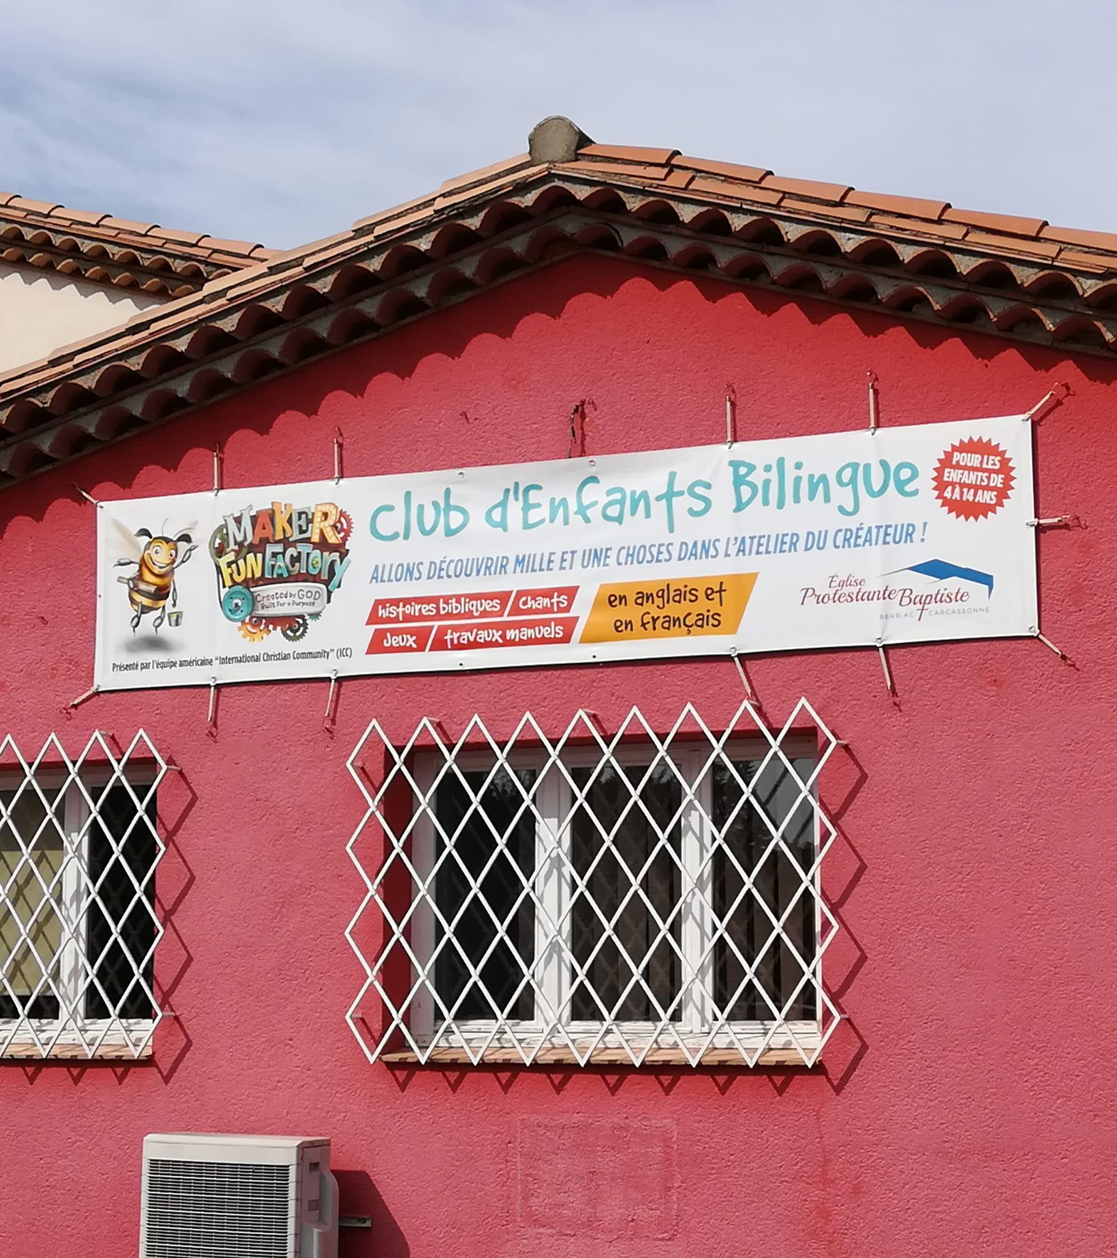
What hasn’t changed?
2) The need
To have 1 evangelical church in France for every 10,000 people, over 4,000 churches need to be planted.
https://www.facebook.com/Eglise.Protestante.Baptiste.Carcassonne/?locale=fr_FR
Notes:
From the France Mission website
As the current population of France is over 65 million, there would need to be over 6,500 evangelical churches in France to have “1 pour 10,000”. That means there are still over 4,000 churches that need to be planted before the goal is achieved…
And while it’s exciting to know that a new evangelical church is planted somewhere in France every 10 days, unless that growth rate accelerates, it will take over 100 years to plant an additional 4,000 churches.

Slide 24
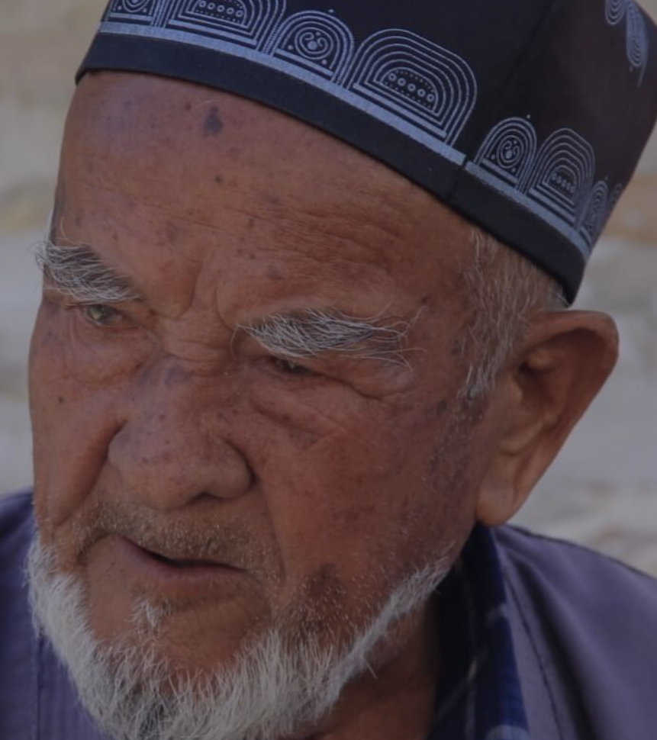
What hasn’t changed?
2) The need
There are 500 million people in Central Asia. Only 0.01% (50,000) of these are Bible believing Christians.
One city of 1.3m (size of Birmingham) only has 25 ethnic believers).
Notes:
This is from the People International website.
Lots of definitions of what is included in CA – but see https://peopleintl.org.uk/ for their list of countries.
To give an example, a well known city in Central Asia with a population of 1.3m – roughly equivalent to Birmingham – has only 25 ethnic believers.

Slide 25
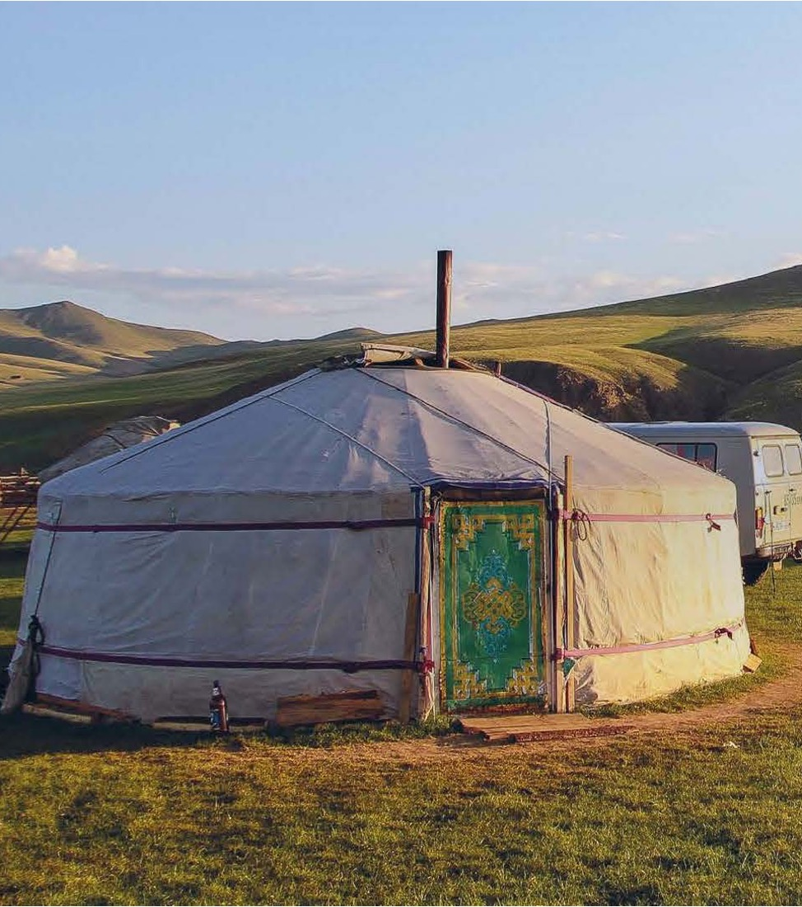
What hasn’t changed?
3) The power of the Gospel
For example, in 1990 there was a handful of Christians and a couple of churches in Mongolia.
Now there are 600 churches and 60,000 believers.
Notes:
Conversation with Mark and Gill

Slide 26
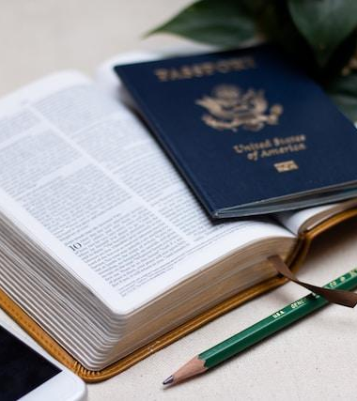
What hasn’t changed?
4) The ‘Great Commission’
Only 17% of US church- going people say they have heard AND remember what the Great Commission is all about.
Photo by Lydia Matzal on Unsplash
Notes:
https://www.barna.com/research/half-churchgoers-not-heard-great-commission/

Slide 27






What hasn’t changed?
5) The opportunity
  Women’s/youth ministry in France
  Christian education in Nicaragua
Some of the recent UFM long-term mission partners.
  Children’s/youth ministry in Kenya
  Church ministry in Georgia
  Medical ministry in Madagascar
  Church planting in Turkey

Slide 28
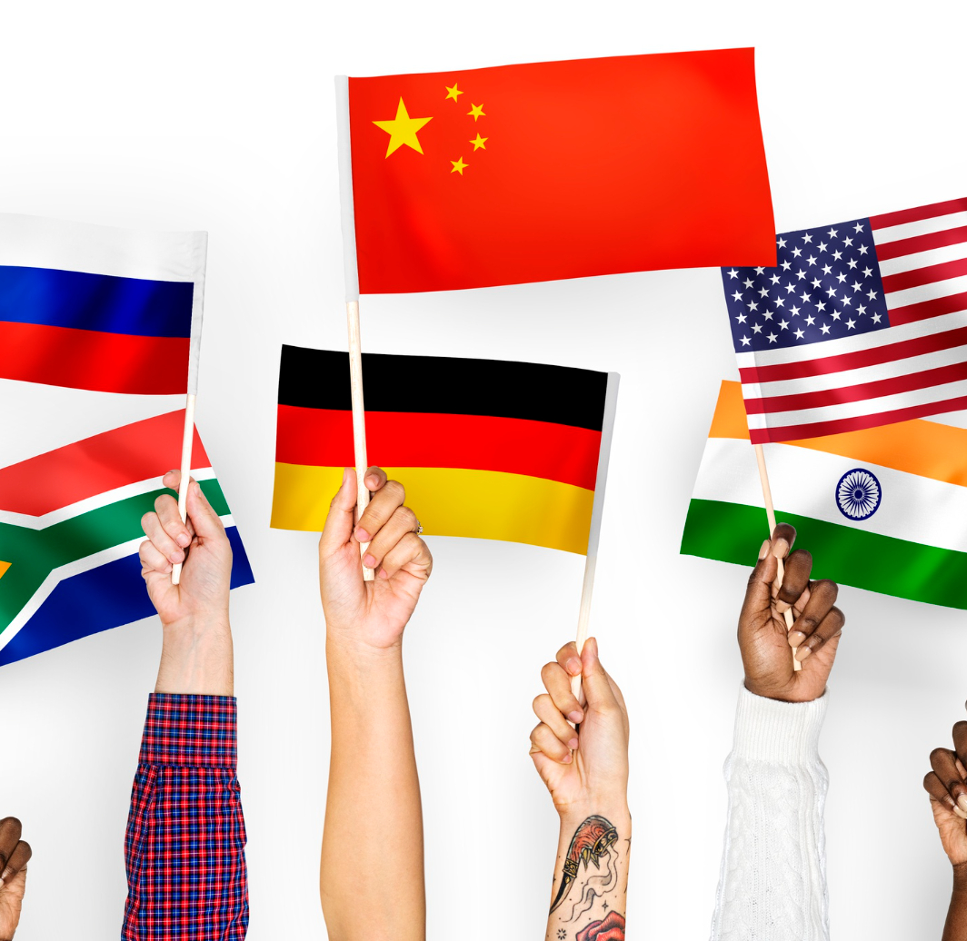


How do we create and cast vision?
See the
Need
Spot the
Opportunity
Sense the
Urgency

