Slide 1

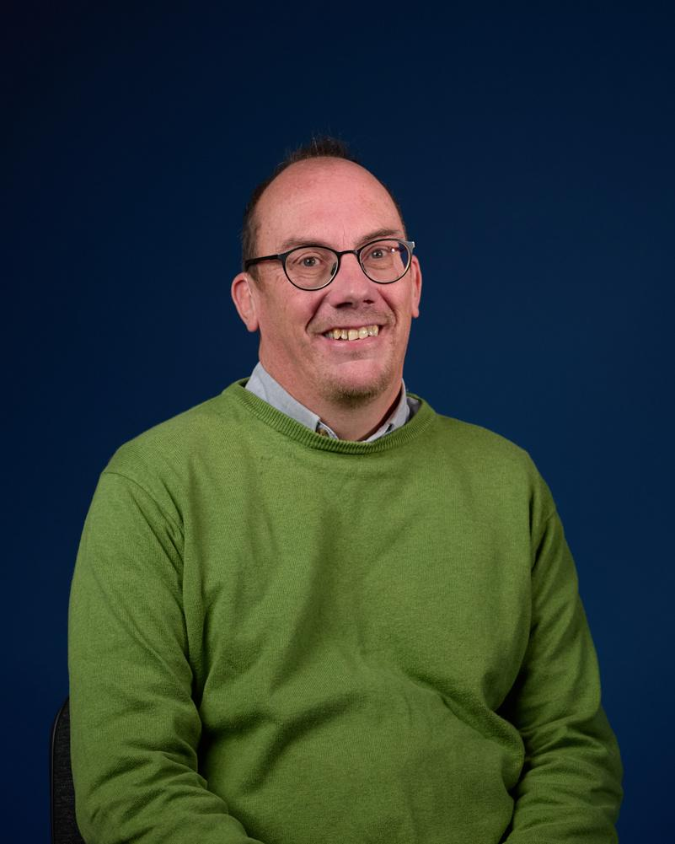

Local churches supporting global mission
PGP Partnership Day
23rd May 2024
Tim Howlett
Head of Partnerships

Slide 2
Local churches supporting global mission
Session 1 – What hasn’t changed?
Session 2 – What has changed?
Session 3 - What can be done?

Slide 3
Local churches supporting global mission
Session 3 – What can be done?
(aka ‘what should church leaders do?’)

Slide 4
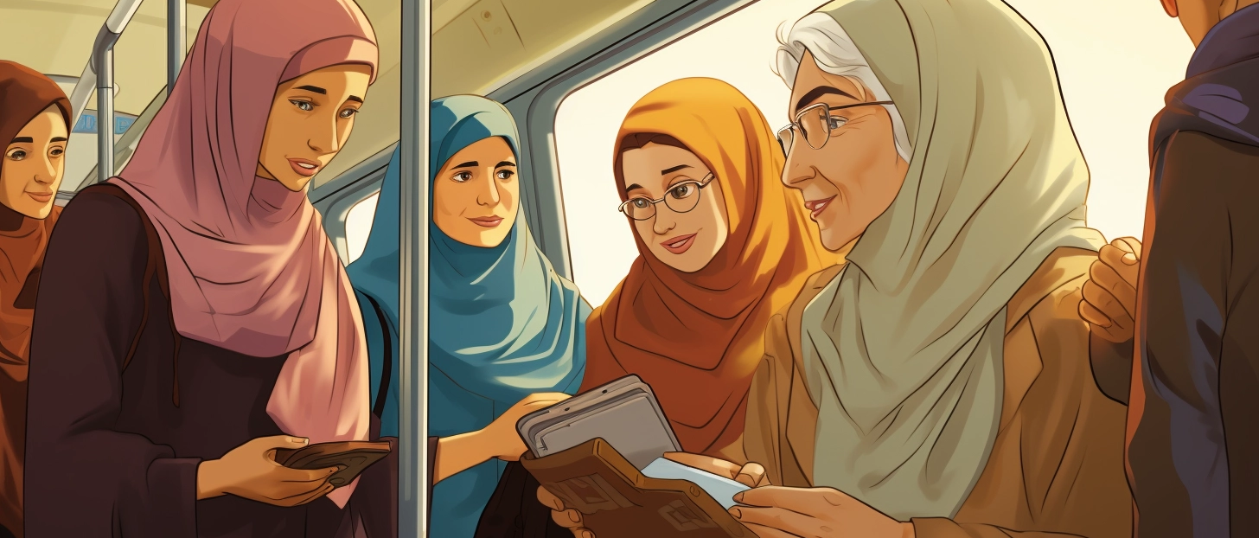
What can be done? Praise God
Notes:
Lady on a bus in Iran
IRAN: AMIR and CONNIE DANA - Shared by Amir when he visited the office on 13th January 2023
Summary
Lady on a bus in Iran
Gets a fellow passenger to read the Bible to her
Loud enough for others to hear
Ends up giving lots of passengers Bibles
NB: Care needed in referring to A & C. Best to say a mission partner based in the UK who can’t go back to his home country of Iran.
Full Story
One some/all buses in Iran, the males sit at the front and the females sit at the back.
A 78 year old Christian lady takes a bag of Bibles on the bus (having a physical copy of the Bible is illegal). She sits at the front of the female section (ie the middle of the bus).
When a passenger sits next to her, she asks if she can read. The usual answer is yes and so she asks if she could read some of this book (usually a Gospel).
The lady then says (pointing to her hearing aids) that she needs to read it louder as she is deaf.
At this stage, quite a few on the bus are listening in.
Often, they are amazed by what is being read and so ask what it is. The 78 year old is then able to say “you can keep it - in fact I have plenty of others here.” That way she distributes quite a few Bibles.

Slide 5
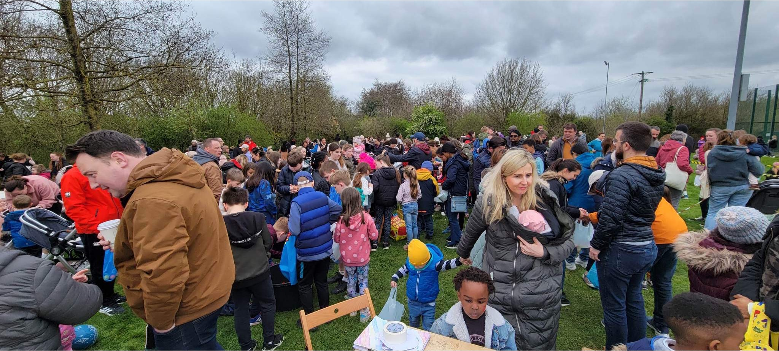
What can be done? Praise God
Notes:
From Seth Lewis – shared at the summer conference.
Details confirmed in an email to Tim Howlett on 11/09
Here are some detail on our Easter egg hunt in Carrigtwohill: we had hoped for maybe 50 children (we would have considered that a brilliant start - our experience in Ireland is that outreach events start small, but have the potential to build over time). On the day, we ended up having more than 250 children come, probably closer to 300. We got to share a brief gospel message about Easter and we had 90 gospel booklets taken that day. We have a team coming from America coming next Easter to help us run the event again, and we will be making adjustments to accommodate the bigger numbers.

Slide 6
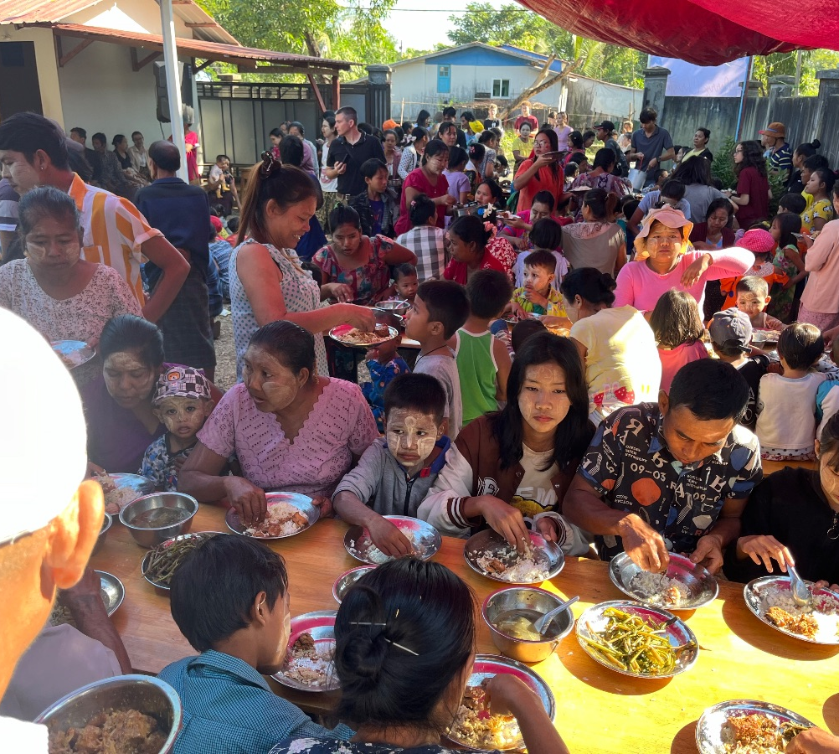
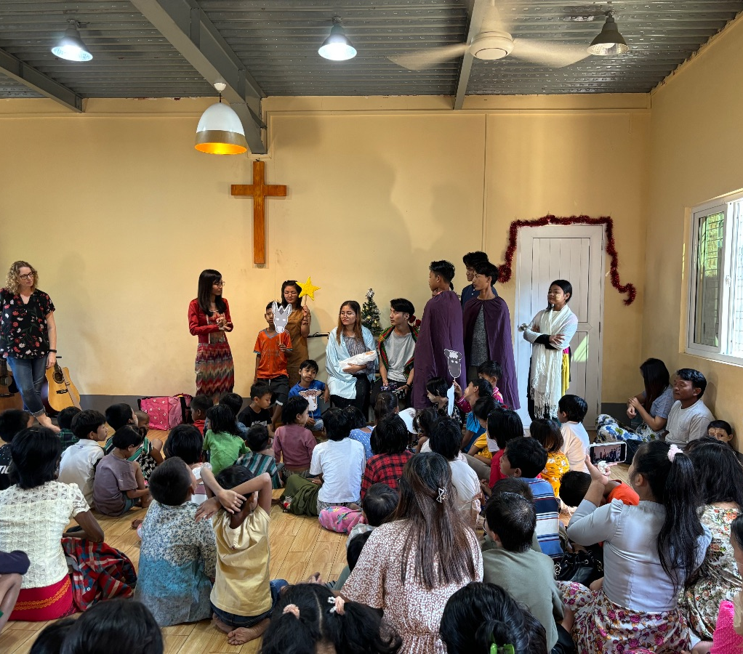
What can be done? Praise God
Notes:
From Tuangpi & Michaela ZAM SUAN January 2024 prayer letter
1)
Our outreach event took place on December 23rd although the church and neighbours were elbow deep in preparations for some days before hand. We invited the community into the church to enjoy a meal and over 800 people came and ate. The youth group that Rosie and Poppy attend (Marvel) joined us and helped serve the food, clear plates, sang some songs and did some face painting. While people ate they listened to live music proclaiming the Christmas message as well as a short gospel presentation. As they left they were handed a tract sharing the meaning of Christmas. We were pleased with how well it went. It was extremely busy at times and we can already think how we could do some things differently next year!
2)
At church we had a short service, ate together, gave gifts and had some fun games. We were amazed by how many people decided to join us. On a normal Sunday morning we get around 70 people but on Christmas Day it was around 150. These are all people connected with the church in some way but who don’t come regularly. It was great to have them with us. In the afternoon people from the closest 200+ families came and collected some rice and oil. People were incredibly grateful for this help as food prices have risen dramatically since the coup.

Slide 7

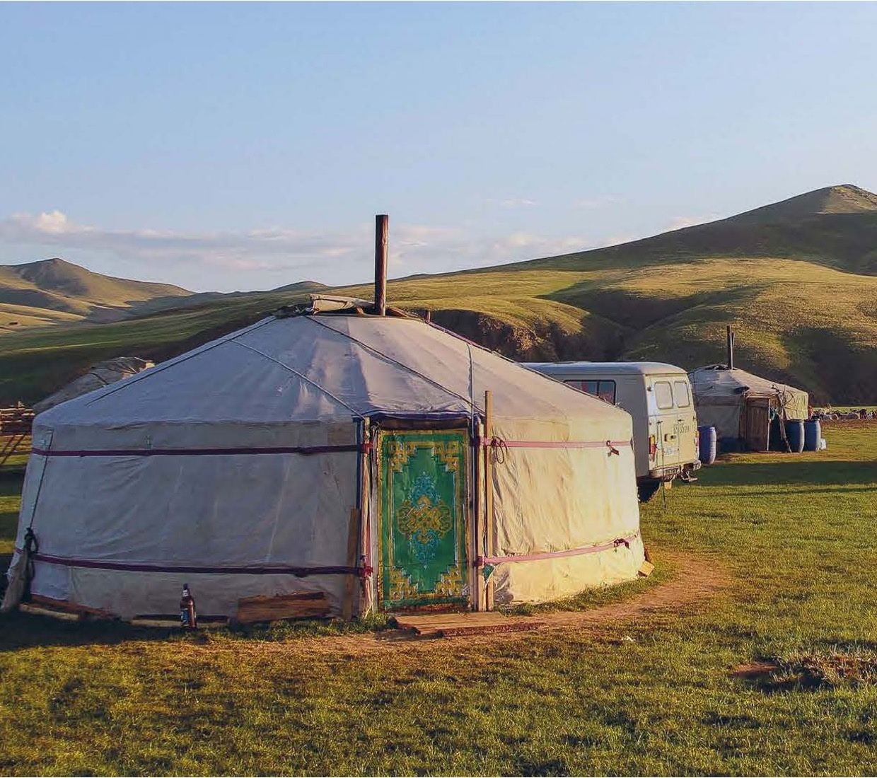
What can be done? Pray
(including diaspora churches)
More long term mission partners from UK churches
Supporting majority world mission sending
Notes:
There is something in the “We are UFM” brochure.
Building on the history of when we were called ”Unevangelised Fields Mission” about 50% of UFM’s mission partners serve among the least reached.
These are places where there are not enough national believers to see the church more firmly established.
Could be evangelism / student ministry / church planting / supporting emerging mission movements

Slide 8
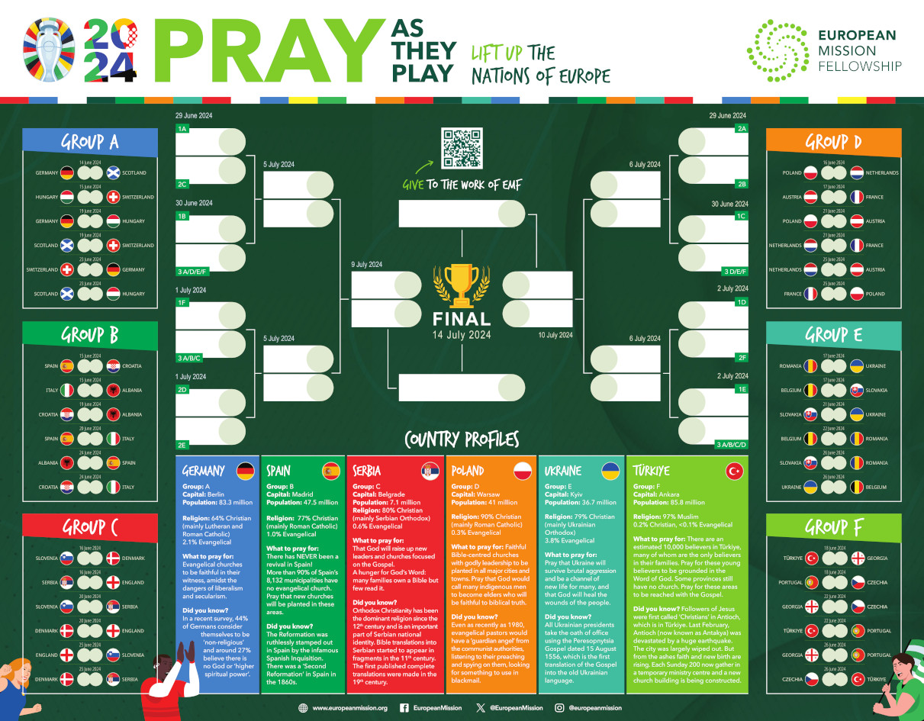
What can be done? Pray

Slide 9
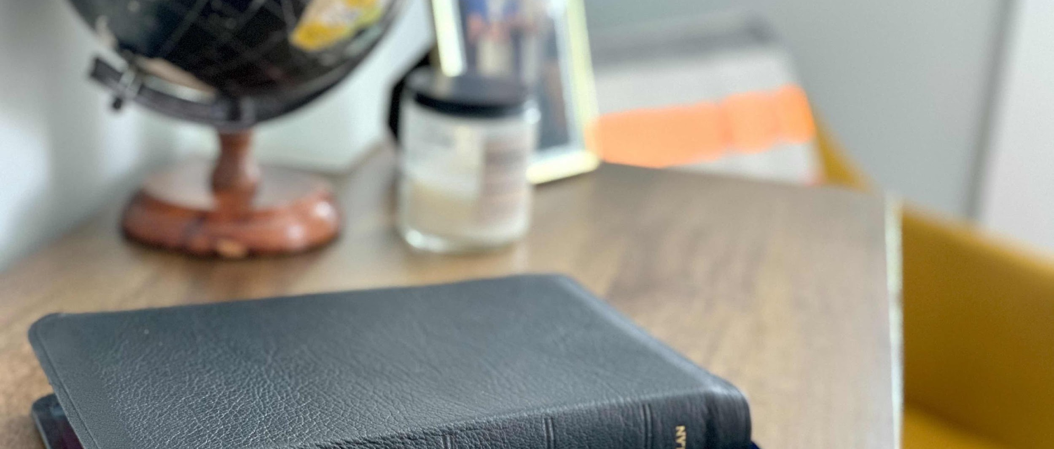

What can be done? Preach, teach, inform and enthuse
Photo by Tim Wildsmith on Unsplash

Slide 10
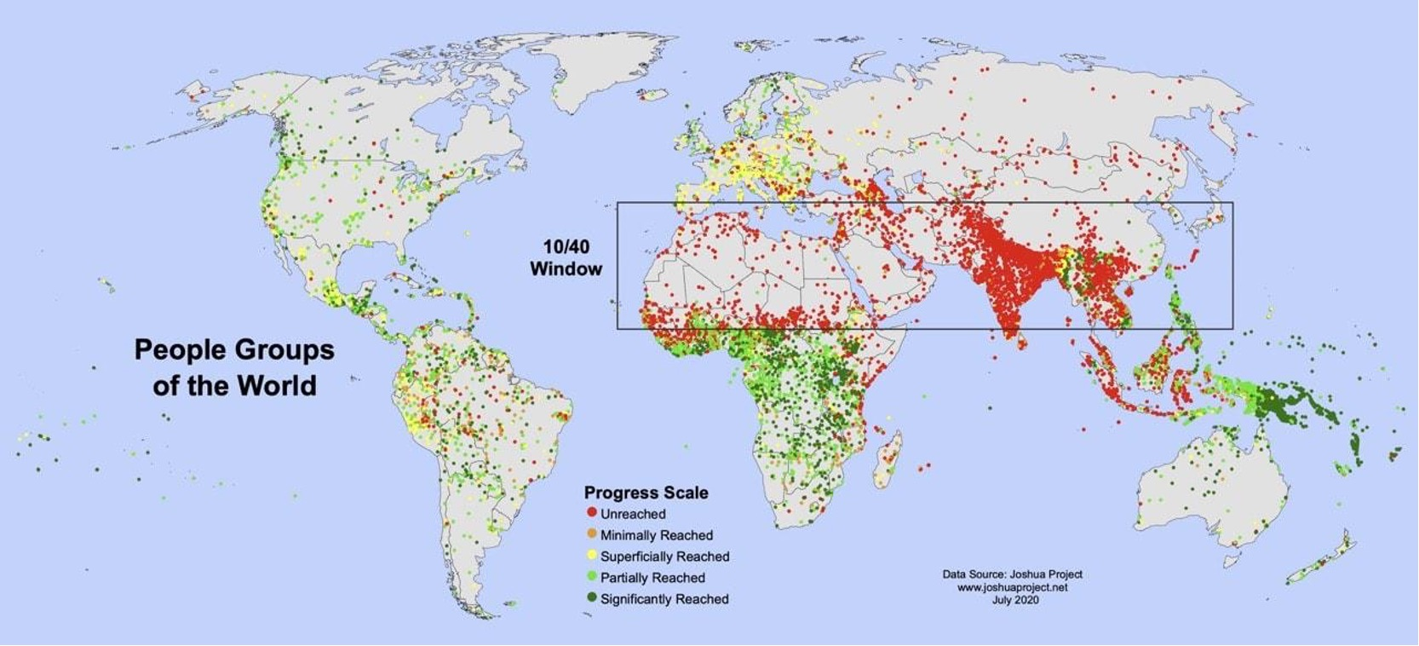
What can be done? Be aware of global realities

Slide 11
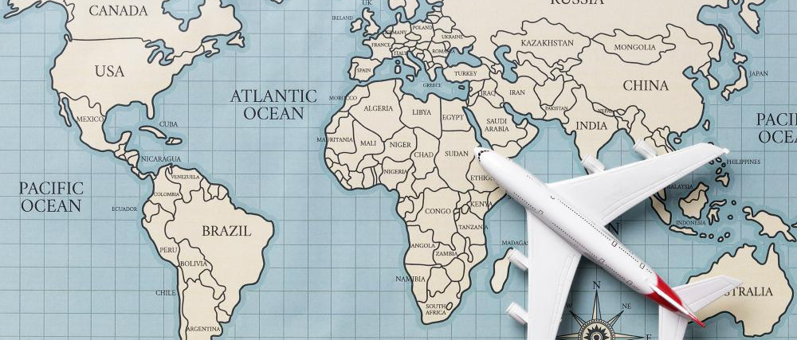
What can be done? Be proactive to identify, train & send …

Slide 12
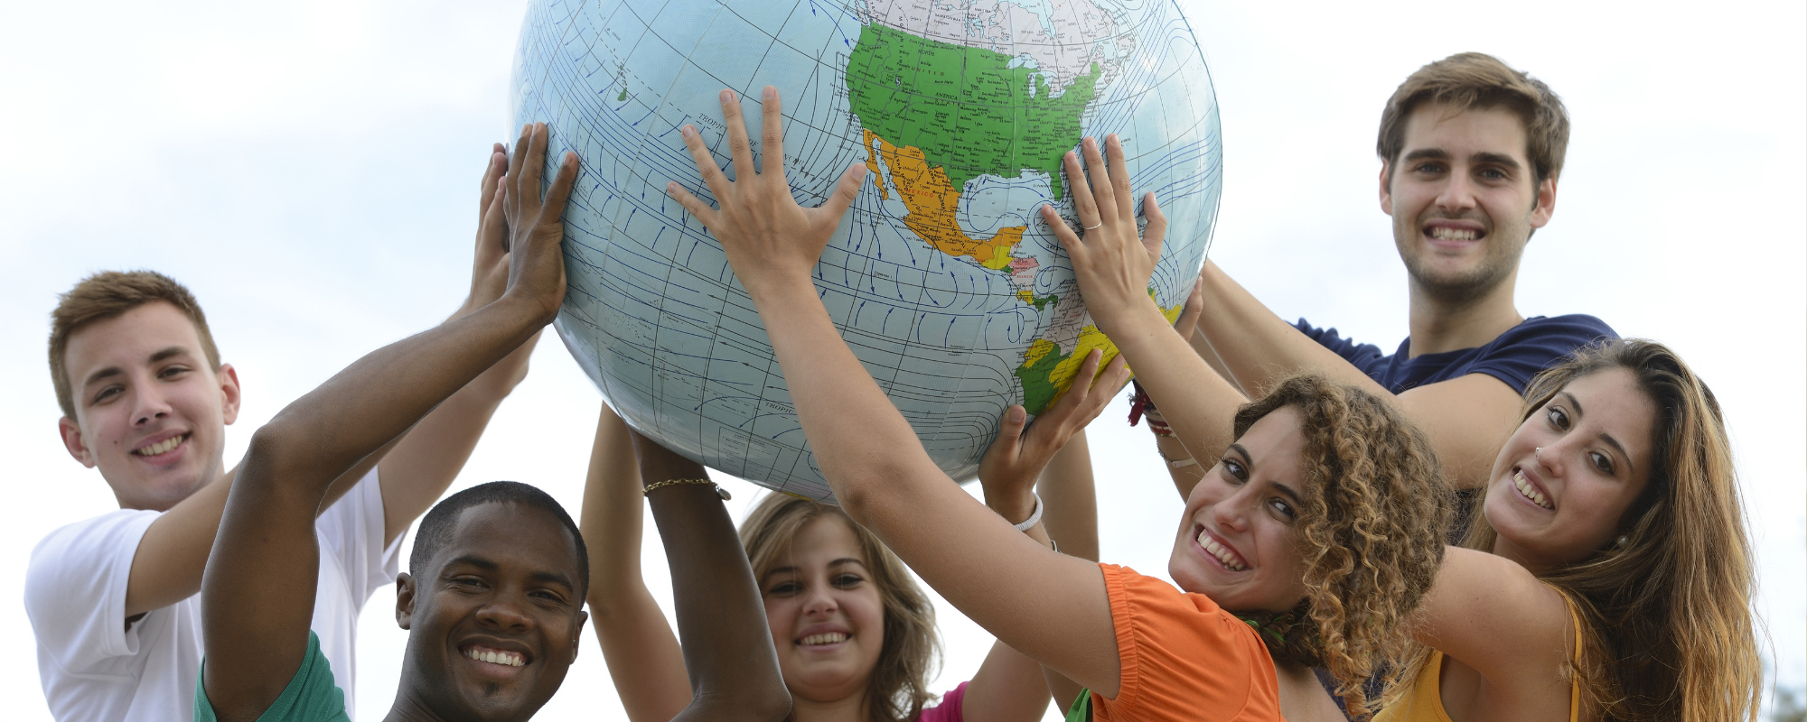
What can be done? … including short-term mission trips

Slide 13
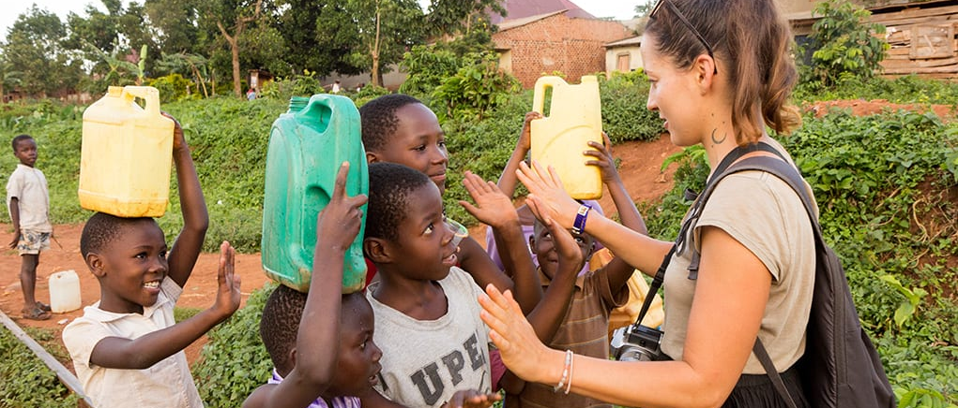
What can be done? ‘Adopt’ a mission partner

Slide 14
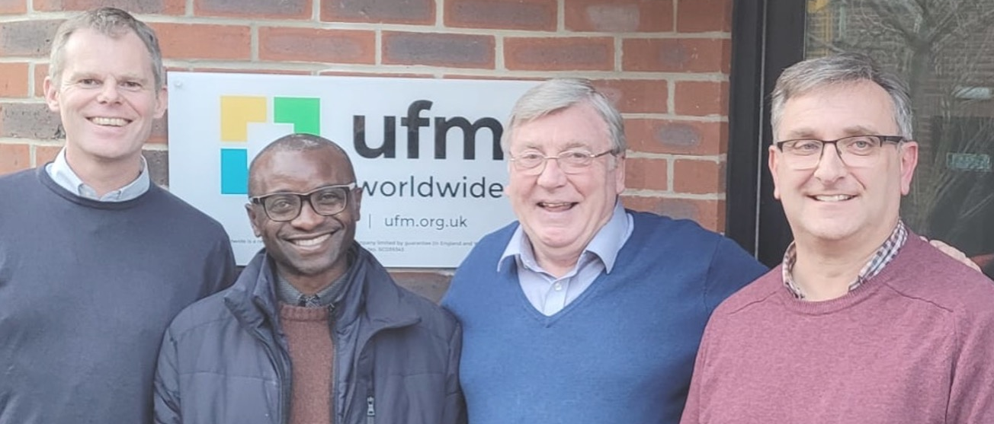
What can be done? Learn from what is happening globally
Notes:
Eg we asked Ernest what we could learn from the Zambian church and his answer was passion

Slide 15
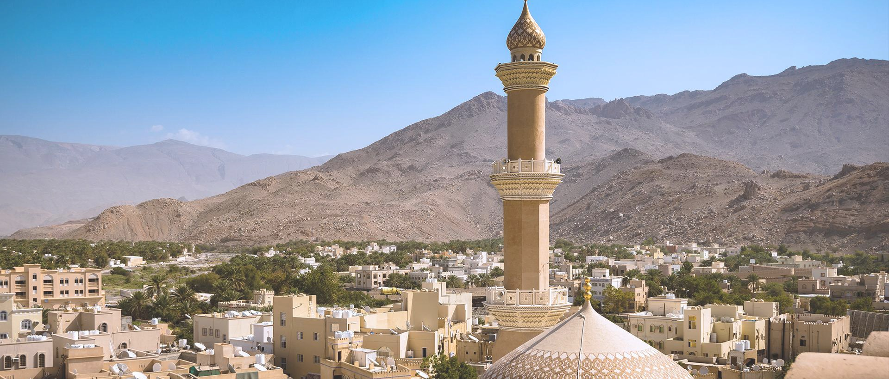
What can be done? Keep perspective

Slide 16
Thank you!
Any questions?
tim@ufm.org.uk

